Slide 1
Group 6
DMT-V

Slide 2
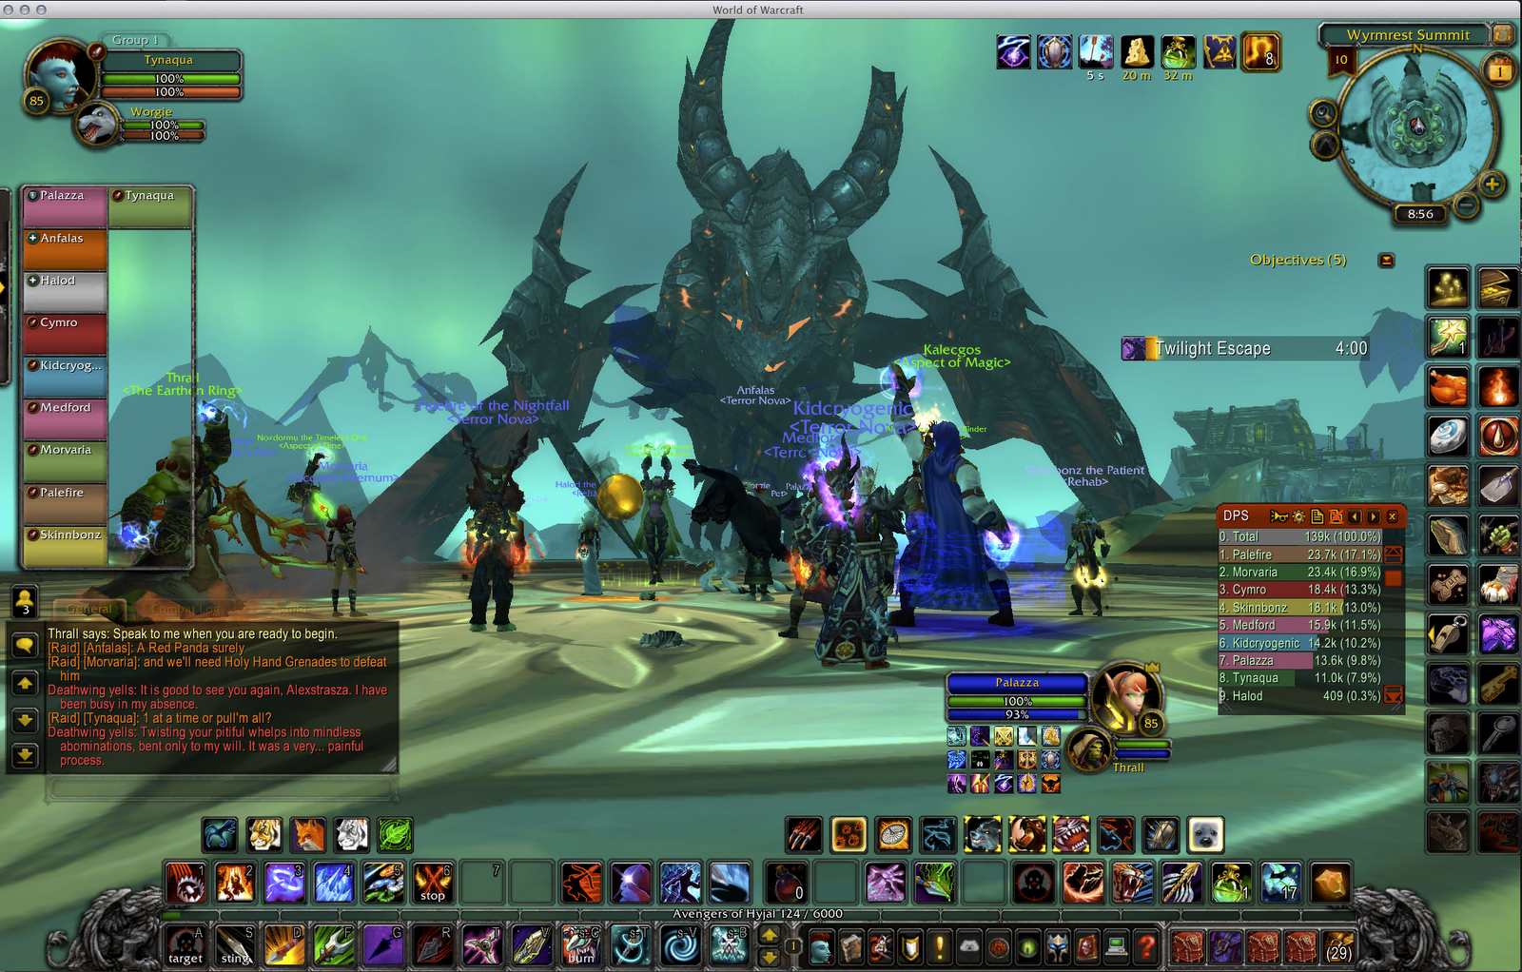
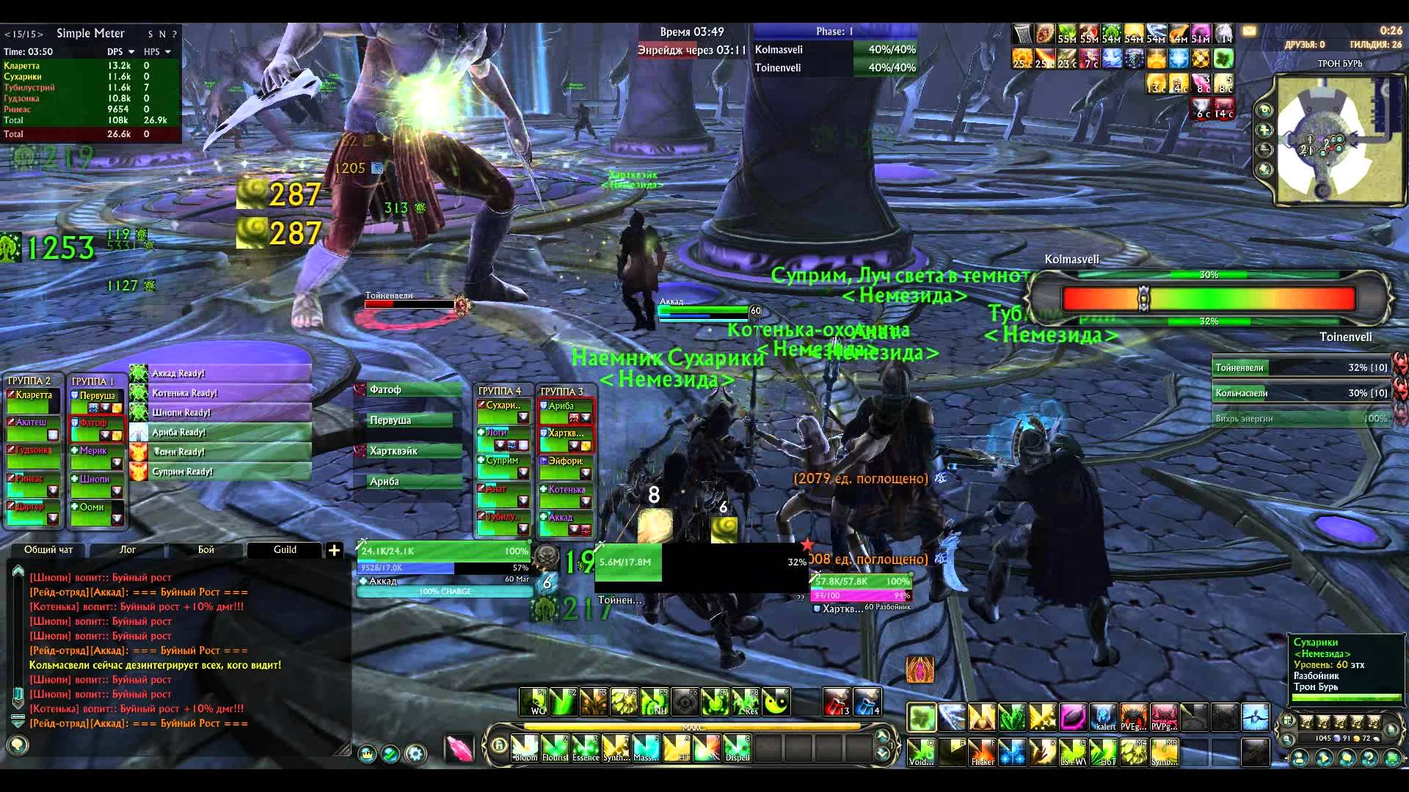
Introduction
Video game that will allow 3 to 5 players to fight AI controlled monsters in a dungeon-like setting.
The game will focus on gameplay over story, providing RPG mechanics to allow the players to imagine their own story.
World of Warcraft (2004) Blizzard Entertainment
Rift (2011) Trion Worlds

Slide 3
Approach
Problem : Dungeon crawling games that have been created take too long in building gameplay. The player spends hours to achieve better weapons and increase their player level.
Solution: Creating a game that has improved mechanics and fast game play. This allows the player to enjoy the core of a game at a faster rate.

Slide 4
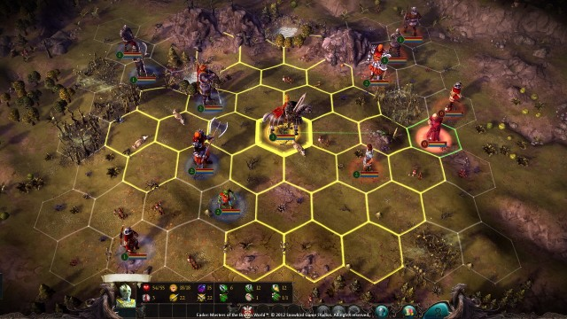
Focus
Gameplay-driven over storyline
Multiplayer over singleplayer
Platform
Desktop, Windows OS (7 and newer)
Genre
Top-Down, Turn-Based, Roguelike, RPG, Dungeon Crawler, Multiplayer, Strategy
Target Audience
Those who enjoy both RPG's and MMO’s raid mechanics
Eador: Masters of the Broken World. (2013). Snowbird Games.

Slide 5
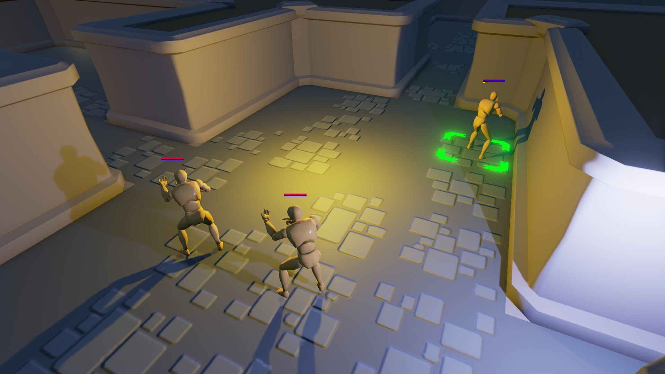
Resources
Unreal Engine 4
C++
Blueprints
Slate UI Framework
Built-in multiplayer capabilities
Blender
Custom textures and design
FL Studios 11
Background music
Turn-Based Strategy. (2016). Epic Games.

Slide 6
Requirement Specification
Short, 3-5 words per requirement
(Functional) Include multiplayer functionality: Too much information for a slide.
Client\Server Model.
An in game chat system will not be provided.
An area for people to find other people to play with will not be provided in the game. I was thinking “No Multiplayer Lobby”?
Internet connection (56Kbps or faster)
Only 1 user designated as “server”. All others will be clients to this server
The server (and only the server) will maintain a single copy of the GameMode actor.
The server will provide each client with a GameState actor Merge with 8,9 ?
Server will provide clients with current map when they connect
Successful client connections will receive a temporary PlayerController to replicate
Remote Procedure Call (RPC) will be used to update map and state changes

Slide 7
Requirement Specification (cont)

Slide 8
System Model

Slide 9
Subsystems
Game World (Vishal)
Description: (1 - 2 sentences, precise)
Game Level (Vishal)
Description:
User Interface (Matthew)
Description:
Game Mode (Matthew)
Description: The central hub of the system. It defines the rules for the game and how the other components will interact with one another.

Slide 10
Subsystems (cont)
Player Character (Timothy)
Description: The character that the user interacts with using the UI. This includes the inventory, equipment, and skills.
Non-Player Character (Timothy)
Description: All AI controlled characters within the game.
Game State (David)
Description:

Slide 11
Risks and Feasibility
Problem
No one in the group has experience making full games. This makes it difficult to asses how much can be accomplished in the given time.
Solution
Learning more about video game development from the beginning will help a great deal with many aspects.

Slide 12
Risks and Feasibility (cont)
Problem
Not all members are experienced with C++; no member is experienced with Blueprint.
Solution
Many tutorials on C++, very good to learn anyway.
Majority of Unreal Engine can be used with C++, so Blueprint can be learned at a slower pace.

Slide 13
Risks and Feasibility (cont)
Problem
Video game development has many different roles (artists, storyboard writers, animators, etc.) that are not fully present in our team full of programmers.
Solution
Indie game development is well-supported, many free assets and other resources.
Focus on the gameplay instead of the story or art.

Slide 14
Timeline
Gantt chart

Slide 15
Design Decisions
i ) Use a well-established game engine or build backend from scratch.
Existing Game Engine (Unreal Engine 4)
+Overall less time spent coding the backend.
+Less risks using an established game engine that is known to work.
+Easier to synchronize different components of the project.
+A standard engine will allow other people to easily add to this open-source project.
-Learning how to use the game engine will take time.
Building Our Own
+More control over how the game will function.
-Problems may arise when attempting to synchronize the game engine with other components.
-Coding other parts of the game might need to wait until the basic mechanics are mapped out.

Slide 16
Design Decisions (continued)
ii) Choosing to focus on the gameplay rather than the story.
Gameplay-Driven
+As the medieval/fantasy genre is the most popular for RPGs, players should be able to understand the context without a major backstory.
+In dungeon-crawlers and rogue-like, the mechanics of the game are often more important than the story.
-Without a story, flaws in the gameplay or mechanics can be more noticeable (i.e, players may be more forgiving of gameplay flaws if it had a good story).
Story-Driven
+People may be more interested in the game if it had a compelling story.
+Many resources are available for the medieval fantasy genre.
-Less time will be spent on the mechanics.
-A story can limit our options when designing the game.

Slide 17
Design Decisions (continued)
iii) Turn-based system instead of free-roam system
Turn-Based
+Much easier to synchronize multiplayer with a turn-based system.
+Gives players more time to think about their decisions, inherently adding strategic elements to the game.
+Places more emphasis on planning movements and actions with the entire group rather than individual skill.
+It is easier for new players to get into turn-based games, as they have time to think and react.
+Active movement in the game can be synthesized with motion in the gameworld.
-Players may get bored if a teammate is taking too long with their turn.
-Turn-based combat can be less exciting.
Free Roam
+The combat and movement system will feel more fluid and immersive.
-Planning, resource, and programming intensive for the movement system and other various animations.
-Without restricted movements, players can encounter bugs more frequently.
-Balancing will be harder to accomplish if the combat is not limited in some way.

